Slide 1
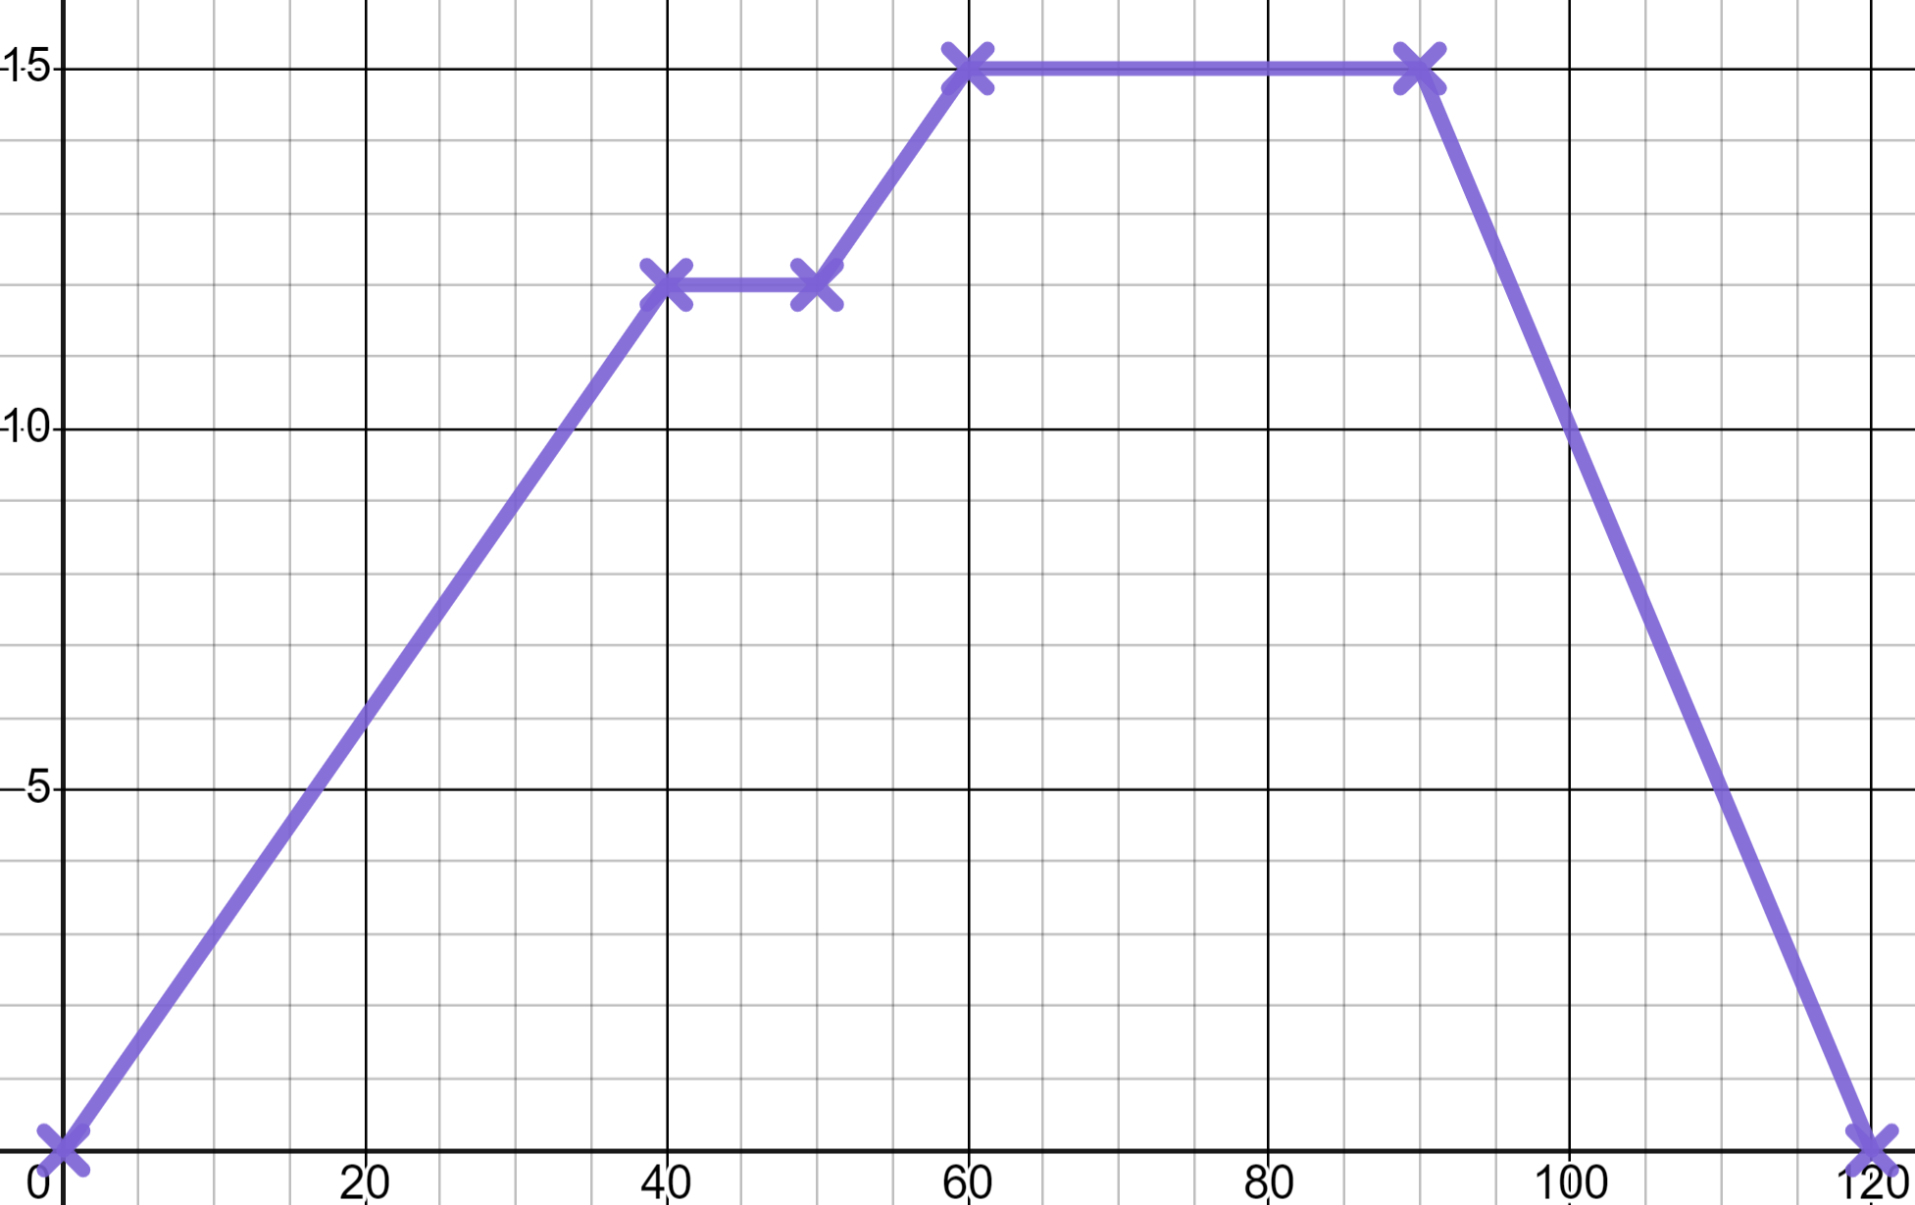

Modelling with graphs
Task A: Reading distance time graphs
1) Here is a distance time graph of a cycle ride that Jacob took.
a) How far away was he at 30 minutes?
15
✖
(90, 15)
At 9 km
b) What happened on 40 minutes?
distance (km)
A 10 minute stop.
10
(30, 9)
✖
c) At what time did Jacob start to return home?
On 90 minutes.
5
d) How far did Jacob cycle in total?
30 km
15 km out and 15 km back.
20
40
60
80
100
120
e) Was Jacob’s furthest point from home the high point, or low point, in altitude of this cycle? Write a sentence to justify your answer.
The high point.
You might have written:
“The gradient on the journey home is the steepest part of the graph which tells us it is the highest speed.”
“Jacob has a break on the way there but, not on the way back. This would suggest the route back was easier (i.e. downhill)”
You were not allowed to write:
“The return journey is going downhill on the graph”
time (mins)
2) Alex shows you a distance time graph which he drew before this lesson. He now knows there are moments in it which can not be true.
For each labelled moment declare if that moment is possible or impossible and write a sentence explaining why.
You might have written:
d)
a)
Possible - This a is stop in the journey.
distance from home (m)
b) and e)
Impossible - This would be a change in position in zero time.
b)
c)
e)
c)
Possible - This is a move towards home at a constant speed.
a)
d)
Impossible - This would represent going back in time.
time (mins)

Slide 2
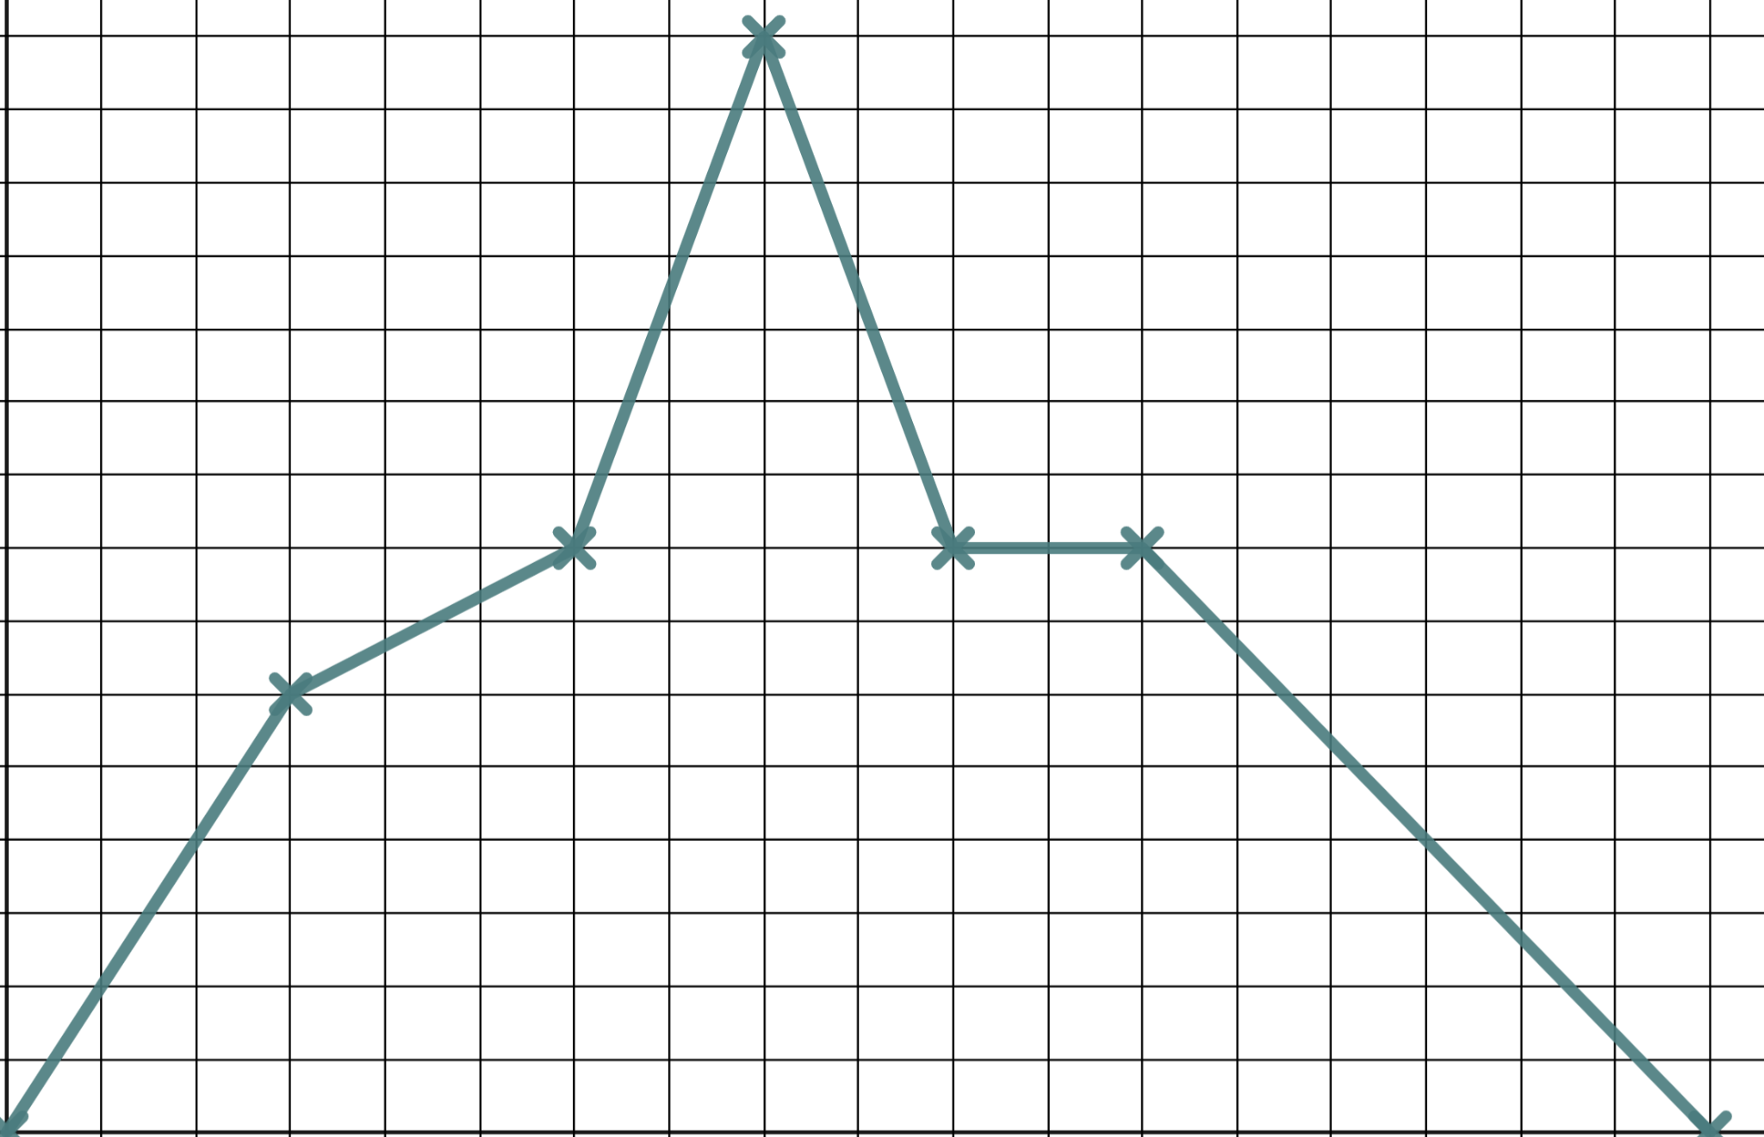


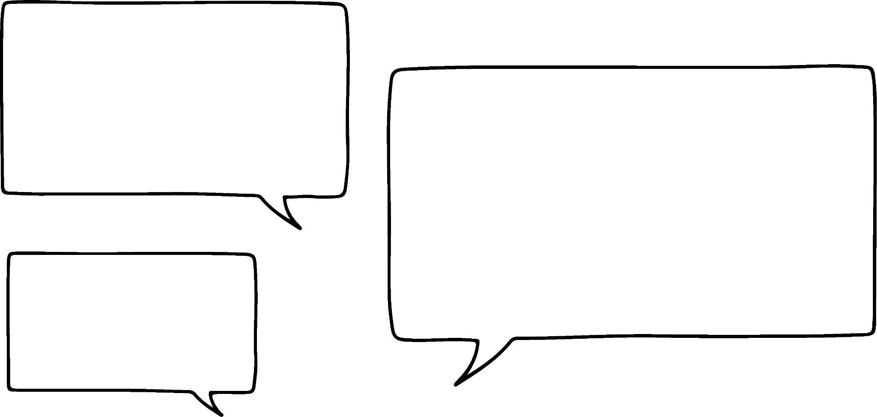

Modelling with graphs
Task B: Drawing distance time graphs
1) Use the grid to plot Jacob’s long distance training ride.
“We cycle 12 km in half an hour. In the next half hour we only cycle 4 km. We speed up and cycle 14 km in 20 minutes then turn for home cycling 14 km in 20 minutes again. We rest for 20 minutes before taking an hour to cycle home after our rest.”
d
30
20
10
0
30
60
90
120
150
180
t
2) Sketch the graph of Izzy’s car journey to visit relatives.
We set off and it takes us half an hour to do 40 km and get to the motorway. In one hour on the motorway we travel 100 km. Then we hit traffic and stop still for half an hour. Then we move slowly doing the final 20 km in an hour.
d
(180, 160)
160
✖
✖
✖
(90, 140)
(120, 140)
✖
(30, 40)
t
180
Mathematics in Education and Industry
v2.3

